Slide 1

Advanced Topics – Architecture
Architectural Concepts, Application Designs, Azure
SoftUni Team
Technical Trainers
Software University
http://softuni.bg

Slide 2
Table of Contents
Web Application Designs
ASP.NET Core Architectures
ASPNET Core MVC vs Razor Pages
Repository Pattern
AutoMapper
Databases & ORMs
ORM vs Micro-ORM
SQL vs NoSQL

Slide 3
Have a Question?
sli.do #csharp-web

Slide 4

Web Application Designs

Slide 5
Web Application Designs
Web applications are the symbol of convenience and comfort
In most cases, they are the preferable over desktop apps
Easy to install, use, update and are not bound to one device
Sure, mobile apps are the new "fashion“
But the demand for complex, refined apps is huge still growing
There are two main designs for web apps
Multi-Page application (MPA) – The traditional approach
Single-Page application (SPA) – The modern approach

Slide 6


Web Application Designs
Multi-Page Applications work in a "traditional" way
Every change requests rendering of a new page in the browser
Displaying listed and formatted data
Submitting data from forms
These applications are large and complex
Larger than SPAs, because they need to be
Some technologies (like AJAX), help reduce the complexity
They ease the constant communication – client / server

Slide 7

Web Application Designs
PROs of Multi-Page applications
Useful for enterprise projects with a lot of features
Very good and easy for proper SEO management
CONs of Multi-Page applications
Front-End and Back-End are tightly coupled
The development and maintenance is quite complex

Slide 8
Web Application Designs
Single-Page Applications work inside the browser
Does not require page reload during use
Serve outstanding UI and design, and are quite elegant
The whole app is in one page – content is changed dynamically
Examples: Gmail, Google Maps, Facebook, Instagram etc.
SPA requests markup and data independently
This is possible thanks to advanced Front-End frameworks
Angular, React, Vue, Blazor etc.

Slide 9
Web Application Designs
PROs of Single-Page Applications
SPAs are fast, most resources are loaded only once
Development is simplified and streamlined
Easy to debug with modern browsers
Easy to make a corresponding mobile application
Reusing the same Back-End
Magically-Dynamic page content change
The average users go "woah".

Slide 10
Web Application Designs
CONs of Single-Page Applications
Quite tricky, and not easy to make SEO of the app
Slow to download, because of heavy Front-End frameworks
Compared to "traditional" apps, SPAs are less secure
Complex navigation
Big Bang Refactoring – hard to refactor, upon major changes
In most cases, require the use of 2 completely different technologies
JavaScript

Slide 11

Application Architectures

Slide 12

Application Architectures
Monolithic applications are single-tiered applications
User interface and data access code are combined
The simplest form of architecture – not much segregation
Development and maintenance is quite easy
This is achieved due to lack of modularity and complexity
Monolith apps are recommended only for small projects
Where the scope of functionality does not require abstractions
In most cases, monolith apps are not desired

Slide 13





Application Architectures
Service-Oriented Architectures (SOA) are "properly" developed apps
Usually incorporate functions into small/mid-sized projects
Communication is established over a set of APIs
HTTP APIs, Asynchronous messaging services etc.
Services do multiple activities over a single scope of functionality
Customer Management, Logs Management etc.
Disadvantages? – It might be overkill
Architecture becomes quite modular and complex

Slide 14
Application Architectures
Microservices is a complex application architecture style
App is structured as a collection of loosely coupled services
Each microservice implements business capabilities
The size should be minimal, otherwise the service should be split
Enables continuous delivery / deployment of large / complex apps
Microservice Architecture is not a silver bullet
Developing distributed systems can be quite complex
Data access management can be quite painful

Slide 15

Application Architectures

Slide 16
ASP.NET Core MVC vs Razor Pages
Apart from MVC, ASP.NET Core provides another approach
Enter Razor Pages! An Model-View-ViewModel-like framework
Razor Pages are similar to View Components
Model & Controller code is included in the Page itself
Enables two-way data binding and simpler development
Perfect for simple applications
With read-only functionality, or simple data input
The Single Responsibility is strong in this one

Slide 17

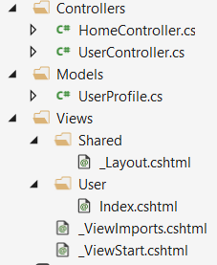
The MVC Approach
public class UserProfile
{
public string FirstName { get; set; }
public string LastName { get; set; }
}
@model UserProfile
<h1>Welcome</h1>
<p>Hey @Model.FirstName!</p>
public class UserController : Controller
{
public IActionResult Index()
{
// This would normally be extracted from the database
var model = new UserProfile
{
FirstName = "Jon",
LastName = "Hilton"
};
return base.View(model);
}
}

Slide 18
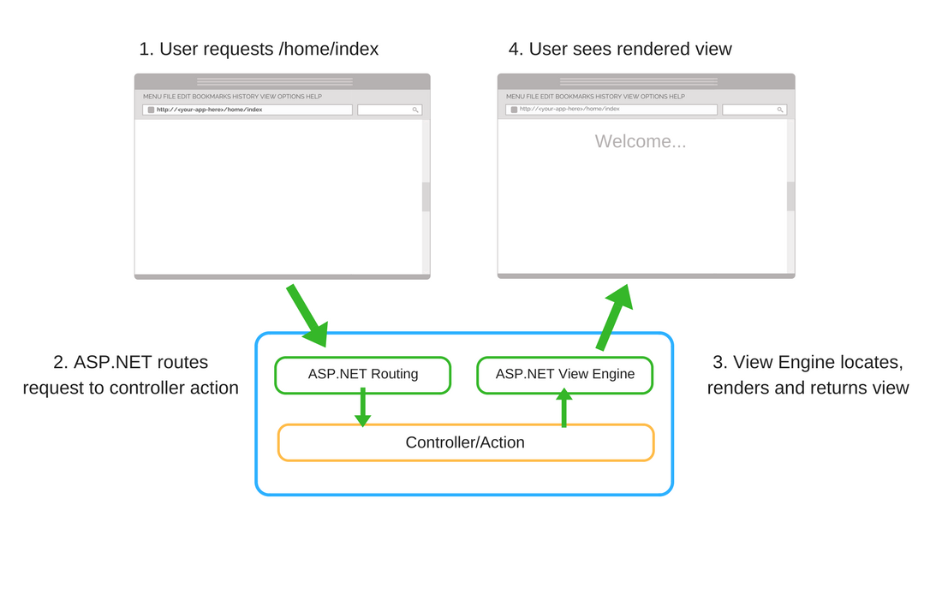
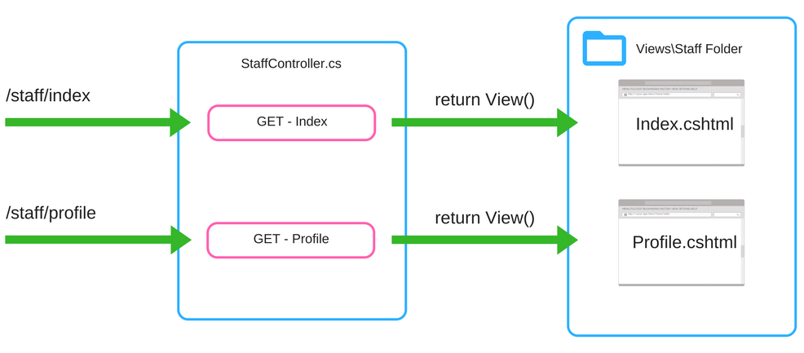
The MVC Approach

Slide 19
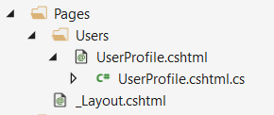
The Razor Pages Approach
public class UserProfileModel : PageModel
{
public string FirstName { get; set; }
public string LastName { get; set; }
public void OnGet()
{
// This would normally be extracted from the database
FirstName = "Jon";
LastName = "Hilton";
}
}
@page
@model UserProfileModel
<h1>Welcome</h1>
<p>Hey @Model.FirstName!</p>
Every Razor Page consists of:
A View template (.cshtml), which acts as a view
A functional (.cs) file, which acts as its controller action

Slide 20
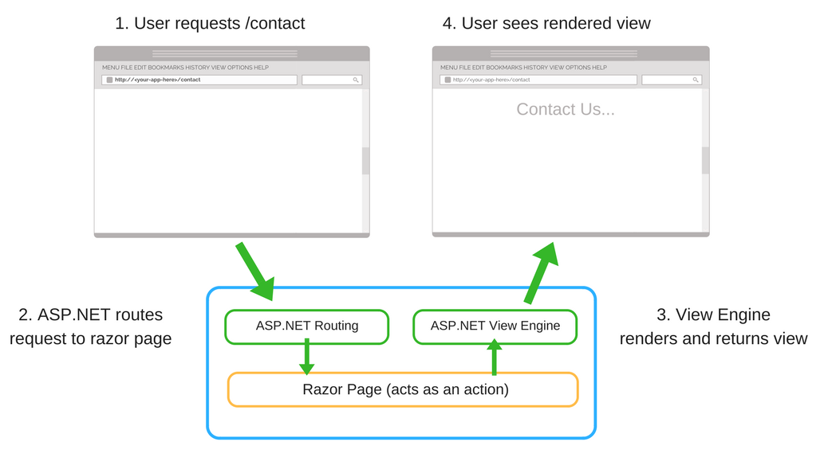
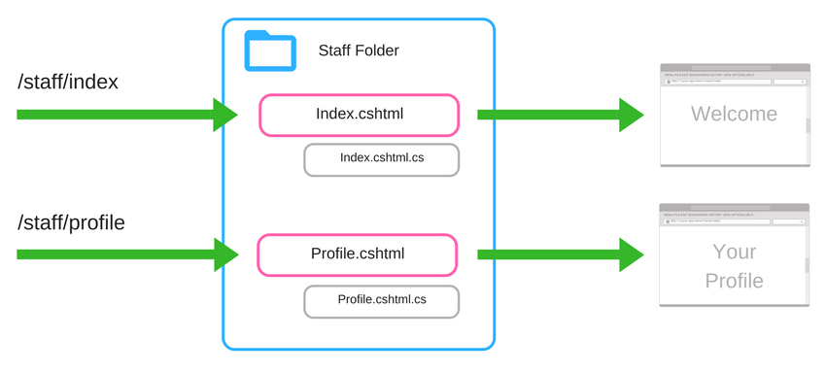
The Razor Pages Approach

Slide 21

AutoMapper
Simplify object mapping

Slide 22



Auto Mapper
AutoMapper is a library built to simplify object mapping
Easily imported in ASP.NET Core
Added as a dependency to the DI
Easy to use in code
Gets rid of ugly property setters
Used in millions of projects
Highly flexible
Easily configurable

Slide 23
Auto Mapper
Setting up the AutoMapper in your ASP.NET Core project
This will also install the main AutoMapper NuGet package
Registering AutoMapper as a dependency in the DI
Install-Package AutoMapper.Extensions.Microsoft.DependencyInjection
public void ConfigureServices (IServiceCollection services)
{
...
services.AddAutoMapper();
services.AddMvc();
}
public class HomeController : Controller
{
private readonly IMapper mapper;
public HomeController(IMapper mapper)
{
this.mapper = mapper;
}
...
}

Slide 24
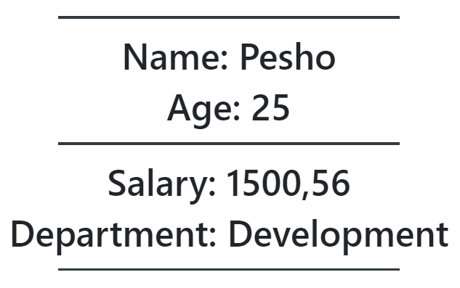
Auto Mapper (Data & Presentation)
Using the AutoMapper in your ASP.NET Core project
public class HomeDataModel
{
public string Id { get; set; }
public string Name { get; set; }
public int Age { get; set; }
public decimal Salary { get; set; }
public string Resume { get; set; }
public string Department { get; set; }
}
public class HomeViewModel
{
public string Name { get; set; }
public int Age { get; set; }
public decimal Salary { get; set; }
public string Department { get; set; }
}
@model Demo.App.Models.HomeViewModel
<div class="mt-4">
<h1 class="text-center">Name: @Model.Name</h1>
<h1 class="text-center">Age: @Model.Age</h1>
<h1 class="text-center">Salary: @Model.Salary</h1>
<h1 class="text-center">Department: @Model.Department</h1>
</div>

Slide 25
Auto Mapper (Business Logic)
Without AutoMapper
Ugly, mistake-prone, unreadable
With AutoMapper
Clean, beautiful, simple
Commonly-syntaxed
Easily modifiable
public IActionResult Index()
{
var homeDataModel = this.GetHomeDataModel();
var homeViewModel = new HomeViewModel
{
Name = homeDataModel.Name,
Age = homeDataModel.Age,
Department = homeDataModel.Department,
Salary = homeDataModel.Salary
};
return this.View(homeViewModel);
}
public IActionResult Index()
{
var homeDataModel = this.GetHomeDataModel();
var homeViewModel = this.mapper
.Map<HomeViewModel>(homeDataModel);
return this.View(homeViewModel);
}

Slide 26

Integrating AutoMapper
Live Demo

Slide 27
Repository Pattern
Abstracting the data access logic

Slide 28
Repository Pattern
Repositories are components that encapsulate data access logic
They centralize common data access functionality
They provide better maintainability and testability
They decouple the data access infrastructure from the Domain layer
For each aggregate, you should define one Repository
Repositories, basically, allow you to populate data in-memory
Data is mapped from database to Domain Entities
Once in-memory, entities can be changed and persisted back

Slide 29


Repository Pattern
Normally you implement specific Interface-Class pairs.
There are other ways, though. Like Generic Repositories, for example
public interface IRepository<TEntity>
{
IQueryable<TEntity> All();
void Add(TEntity entity);
void Update(TEntity entity);
void Delete(TEntity entity);
Task<int> SaveChangesAsync();
}
public class EfRepository<TEntity> : IRepository<TEntity>
{
private ApplicationContext context;
private DbSet<TEntity> dbSet;
public StudentRepository(ApplicationContext context)
{
this.context = context;
this.dbSet = this.Context.Set<TEntity>();
}
public IQueryable<TEntity> All() => this.DbSet;
public void Add(TEntity entity) => this.DbSet.Add(entity);
public void Update(TEntity entity) { ... }
public void Delete(TEntity entity) { ... }
public Task<int> SaveChangesAsync() { ... }
}

Slide 30

Application Architectures

Slide 31
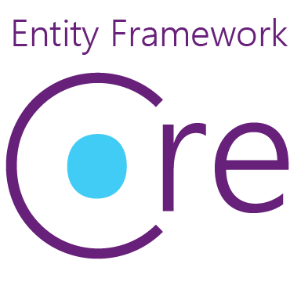
Databases & ORMs
Entity Framework Core is a Object Relational Mapper (ORM)
Creates a layer between your applications and data source
Maps the data to relational objects
EF Core has a lot of essential and convenient features
Generates complex, optimized queries for your convenience
Translated from LINQ expression and cached
Manages the unit of work for you
Tracks changes in the Entities

Slide 32


Databases & ORMs
But EF Core pays a cost for all of its features...
An that cost is performance
But there must be a faster alternative
Enter Dapper! The Open-source Micro ORM
A lightweight micro ORM, and a very fast performing one
Dapper is "Closer to the metal"
Complex querying might be exceptionally hard
Not suited for lazy developers

Slide 33
Databases & ORMs
Developing an application requires the choice of a database
One of the most important decisions in the development
There are 2 general choices that cycle around this question
Relational (SQL) or non-relational (NoSQL) data structure
SQL databases use Structured Query Language (SQL)
Data definition, Data manipulation, Querying, Programmability etc.
NoSQL databases use dynamic schema for unstructured data
Data can be stored as Columns, Documents, Graphs, Key-Value pairs

Slide 34

Databases & ORMs
On one hand SQL seems like the only right choice
Extremely powerful, Versatile, Widely used
A safe choice, especially for complex querying
Very fast performing, even with large sets of data
On the other hand, SQL can be restrictive
Predefined schemas are required to determine the data structure
All of the data must follow that predefined data structure
This requires significant up-front preparation and planning

Slide 35


Databases & ORMs
NoSQL databases have their advantages and disadvantages too
You can create documents without pre-defining their structure
Each document can have its own unique structure
You can add fields on the go
The drawbacks are also important to be noted
Lack of standardization – this affects the community too
Lack of data consistency
Lack of maturity – NoSQL is relatively new

Slide 36

Summary
Web Application Designs
ASP.NET Core Architectures
ASPNET Core MVC vs Razor Pages
Repository Pattern
AutoMapper
Databases & ORMs
ORM vs Micro-ORM
SQL vs NoSQL
…
…
…

Slide 37
https://softuni.bg/trainings/courses

Slide 38













SoftUni Diamond Partners

Slide 39

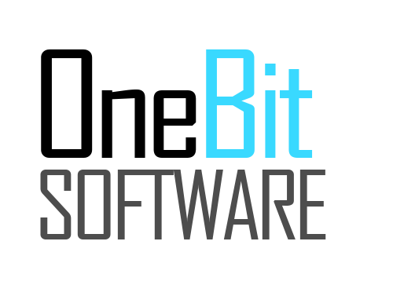



SoftUni Organizational Partners

Slide 40




Trainings @ Software University (SoftUni)
Software University – High-Quality Education and Employment Opportunities
softuni.bg
Software University Foundation
http://softuni.foundation/
Software University @ Facebook
facebook.com/SoftwareUniversity
Software University Forums
forum.softuni.bg

Slide 41

License
This course (slides, examples, demos, videos, homework, etc.) is licensed under the "Creative Commons Attribution-NonCommercial-ShareAlike 4.0 International" license

